Slide 1
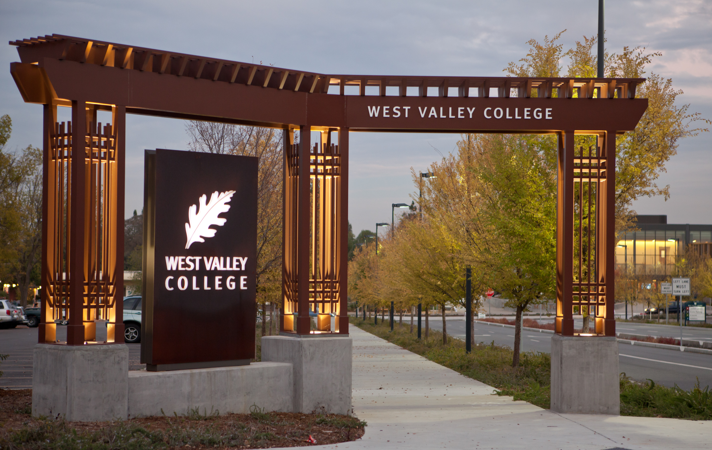

ACCREDITATION AND INTEGRATED PLANNING
All College Day
August 24, 2012
Notes:
Kuni
Introduction of all speakers and brief introduction of presentation

Slide 2


Accreditation
Accreditation is for everyone
REAFFIRMED
Notes:
Kuni

Slide 3

What is accreditation?
Accreditation validates an educational institution’s standing to offer courses, certificates, degrees, and student service programs per the standards of the Accrediting Commission for Junior and Community Colleges (ACCJC).
If WVC loses its accreditation,
it would cease to exist
as a college.
Notes:
Kuni

Slide 4
Accreditation Cycle
Six year process
Three year
mid-year report
Six year comprehensive report and team visit
2007
WVC accreditation reaffirmed
March 2011
mid-term report upholds status
March 2014
comprehensive report and team visit
Notes:
Heidi: top line
Kuni: bottom line

Slide 5
Accreditation
Timeline and Plan
2011-12
Preparation
Institutional Framework
Steering & Disjoint committees
Training
2012-13
Writing
Organizing evidence
Steering/writing committees meet
Address areas to improve
2013-14
Prepare for submission & visit
College wide review
Finalize draft
Submit final report
Team Visit - March 2014
Notes:
2011-12: Kuni
2012-13: Heidi
2013-14: Kuni

Slide 6

Accreditation Story
When we write our report for the Accrediting Commission for Junior and Community Colleges (ACCJC), we tell
our
Our goal
is to receive a “reaffirmation”
status.
collective college story of
successes, accomplishments, and
overcoming challenges.
collective college story of
successes, accomplishments, and
overcoming challenges.
Notes:
Heidi

Slide 7


How do we get there?
ELEMENTS OF SUCCESSFUL REAFFIRMATION
Timely and comprehensive plan
Strong steering committee and writing team
Reflection on current status and willingness to change
Data and evidence driven decision making
Broad-based campus wide participation
Notes:
Kuni

Slide 8



Accreditation Standards
I
  Institutional Mission and Effectiveness
II
  Student Learning Programs and Services
III
  Resources
    Human
    Physical
    Technological
    Financial
IV
  Leadership and Governance
Notes:
Heidi

Slide 9
Accreditation Standards
Standard III
Co-chairs: Stephanie Kashima and Frank Kobayashi
Standard III A
Co-chairs: Stacy Hopkins and Herlisa Hamp
Standard III B
Co-chairs: Frank Kobayashi and Steve McCann
Standard III C
Co-chairs: Fred Chow and Scott Ludwig
Standard III D
Co-chairs: Pat Fenton and Stephanie Kashima
I
Institutional Mission and Effectiveness
II
Student Learning Programs and Services
III
Resources
IV
Human
Physical
Technological
Financial
Leadership and Governance
Standard I
Co-chairs:
John Hannigan and Inge Bond
Standard II
Co-chairs: Kuni Hay and Heidi Diamond
Standard II A
Co-chairs: Kuni Hay and Heidi Diamond
Standard II B
Co-chairs: Victoria Hindes and Carol Pavan
Standard II C
Co-chairs: Maryanne Mills and Monet Payton
Standard IV
Co-chairs: Lance Shoemaker and Laurel Kinley
Notes:
Kuni

Slide 10

2012-2012:
The Writing Year
Fall 2012 Focus
Ongoing steering and writing committee meetings
Timely editing
Evidence collection and organization
Coordination of district services
Addressing need to improve areas
Ensuring that integrated planning is at the sustainable continuous improvement level
Notes:
Heidi

Slide 11
Integrated
Planning
College Mission
Program Review & SLOs
Developed Goals
Resource Allocation
Implement-ation
Integrated planning brings it all together
Notes:
Stephanie

Slide 12





Recognizing Needs
Improved Outcomes
By focusing on the relationship between needs and outcomes, we can increase student learning, success, and satisfaction.
Notes:
John

Slide 13


In Action
STUDENT SERVICES
INSTRUCTIONAL AREAS
Notes:
Instructional Areas: Heidi
Student Services: Becky

Slide 14
Elements of Planning
College Mission
Program Review & SLOs
Developed Goals
Resource Allocation
Implement-ation
The college mission informs all areas of integrated planning:
Program Review and Student Learning Outcomes
Goals
Resource Allocation
Implementation
Notes:
Inge

Slide 15
The Accreditation Perspective on Integrated Planning
An effective institution demonstrates a conscientious effort to produce and support student learning, measures that learning, assesses how well learning is occurring, and makes changes to improve student learning.
It also organizes its key processes and allocates its resources to effectively support student learning.
Further, it sets goals to improve its effectiveness consistent with its stated purposes.*
*ACCJC-WASC Accreditation Standards
Notes:
Inge

Slide 16
Integrated Planning Status
Wrote outcomes for all programs and courses
Designed online assessment tool
Conducted program review for all programs
2010-2011
Developed new mission statement
Reviewed 10-11 goals and objectives
Developed 12-13 goals and objectives
2011-2012
Notes:
Stephanie

Slide 17


SLOs: Progress and
Next Steps
Call to action: be prepared for house calls
Complete100% course and program assessment, Fall 2012
Submit ACCJC SLO report, March 2013
Program and institutional assessments in progress
Ensure all syllabi contain course SLOs and assessment methods
Robust dialogue about student learning that is integrated into goals, planning, and resource allocation
Notes:
Heidi

Slide 18


Program Review:
Progress and Next Steps
1
  New questionnaire including SLO assessment questions developed in 11-12
2
  New 2 year program review cycle
2012-13
PROGRAM REVIEW THEMES REPORT
3
  Draft evaluation rubric in progress
4
  Thematic review in progress
5
  Improve online reporting mechanism to be more user friendly
2013-14 BUDGET
Notes:
John

Slide 19
Resource Allocation:
Progress and Next Steps
Program review themes will inform resource allocation decisions in 12-13
Process will continue in 12-13 with the addition of SLO assessment themes
RESOURCES
Instructional Areas
Non-Instructional Areas
Notes:
John

Slide 20
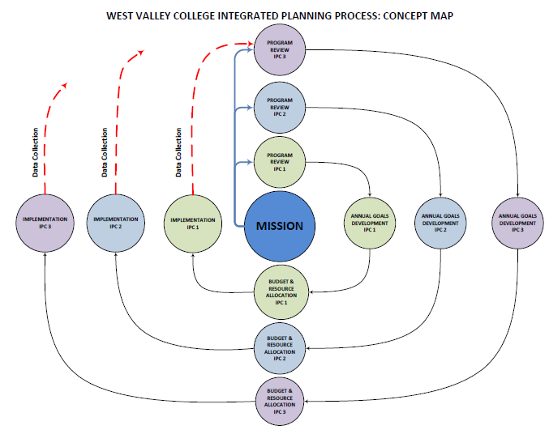
How We Do It: West Valley College Integrated Planning
College Mission
Program Review & SLOs
Developed Goals
Resource Allocation
Implement-ation
Notes:
Stephanie
There is a picture behind the solar system graphic that shows the simplified process.

Slide 21
Integrated Planning: Looking Ahead 2012-13
Complete comprehensive SLO report
Compile comprehensive Program Review reports
Inform College Council goal setting and resource allocation processes
Evaluate12-13 goals and objectives
Notes:
Stephanie

Slide 22
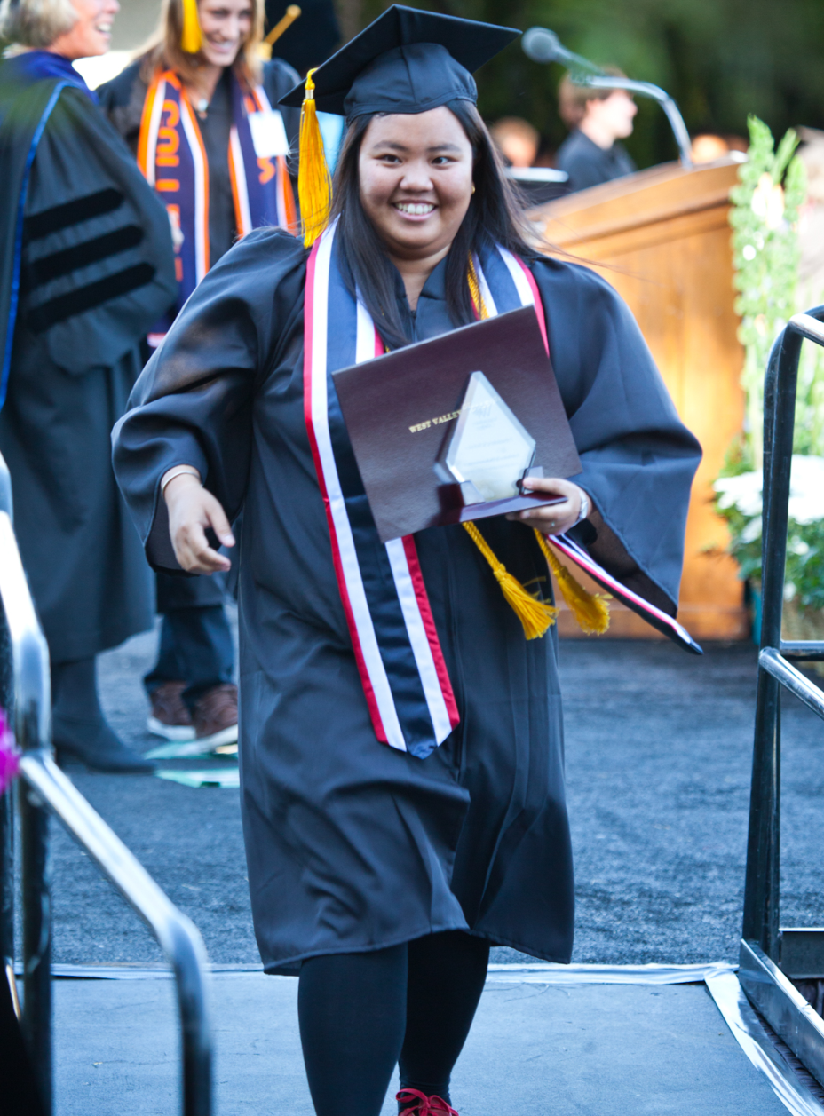


Thank you!
Heidi Diamond
SLO Committee Chair
Inge Bond
Director of Institutional Research
and Planning
John Hannigan
Program Review Committee Chair
Kuni Hay
Vice President of Instruction
Stephanie Kashima
Dean of Instruction and Student Success
Nina Kamath
Freelance Designer
Notes:
Kuni
**Video link is in the West Valley College logo

